Slide 1
Stack

Slide 2

What is a Stack
Stack of Books

Slide 3
Stacks
What is a Stack?
  A stack is a data structure of ordered items such that items can be inserted and removed only at one end.

Slide 4

What is a stack?
An ordered collection of homogeneous items.
Like a stack of coins
We need algorithms
to add things to the
stack and to take things off it

Slide 5
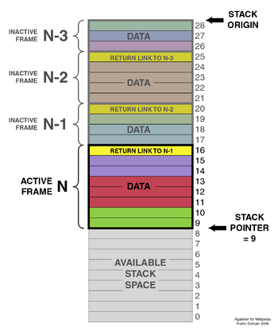

Basic Architecture
Stacks retain
Information
About where to return
Stacks can be used (implicitly) to implement a technique called recursion

Slide 6
Stacks
What can we do with a stack?
  push - place an item on the stack
  peek - Look at the item on top of the stack, but do not remove it
  pop - Look at the item on top of the stack and remove it

Slide 7
Stacks
A stack is a LIFO (Last-In/First-Out) data structure
A stack is sometimes also called a pushdown store.
What are some applications of stacks?
  Program execution
  Parsing
  Evaluating postfix expressions

Slide 8
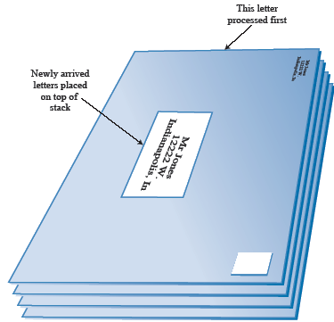
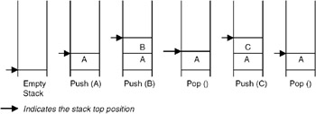
1.Stack
LIFO (last in first out)

Slide 9
Stacks
Problem:
  What happens if we try to pop an item off the stack when the stack is empty?
    This is called a stack underflow. The pop method needs some way of telling us that this has happened. In java we use the java.util.EmptyStackException

Slide 10
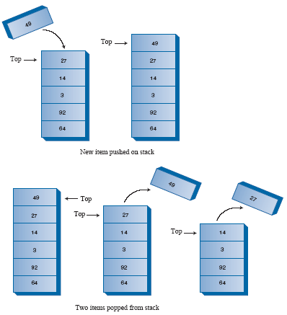
Stack
Managing Top element

Slide 11
Algorithm for Pushing
If we assume an array called “MyStack” and a variable
called “Top” that holds the index of the last data item
pushed on to the stack
Obtain data item X
IF stack is full
THEN reply (“Unable to Push”)
ELSE Top := Top + 1
MyStack(Top) := X
Reply (“X has been pushed onto stack”)
ENDIF

Slide 12
Algorithm for Popping
IF stack is empty
THEN reply (“Unable to Pop”)
ELSE X := MyStack(Top)
Top := Top -1
Reply (“X has been obtained from the stack”)
ENDIF

Slide 13
Applications
Balancing symbols
Reversing a word (mid 1 question of palindrome)
Postfix notation
Infix to postfix conversion

